Slide 1
Welcome!
NJACK’s 3rd edition of the workshop.

Slide 2
What do you know about Machine Learning?
Never heard about it
Heard about it
Kinda know stuff
Know all about it!

Slide 3
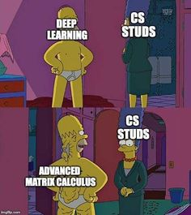
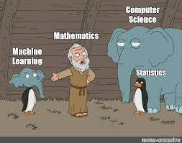

Slide 4
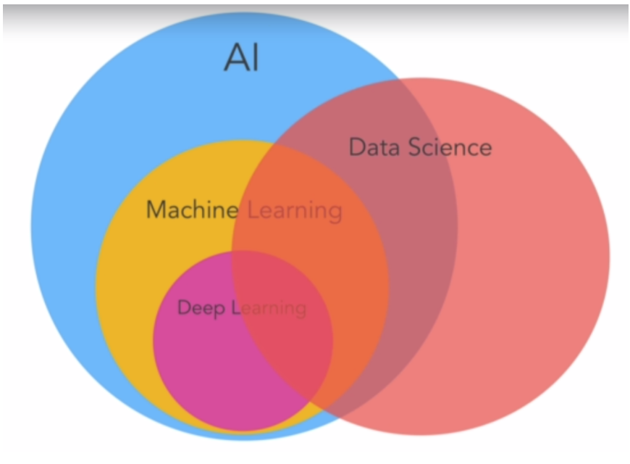

Slide 6
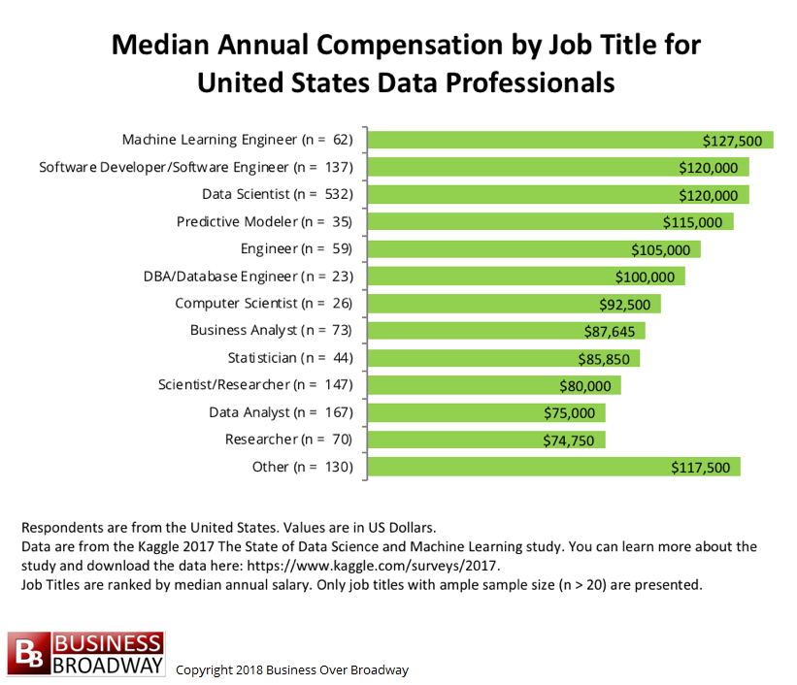
Why should you care?

Slide 7
Top salaries(OpenAI)
Main salaries:
Chris Clark, director/COO: 20h, $41k [$165k other organization - Y Combinator Research Inc.?]
Gregory Brockman, CTO: 40h, $175k
Ilya Sutskever, research director: 40h, $1,900k [base: $900k, $1,000,000 "bonus and incentive compensation"]
Ian Goodfellow, research scientist: 40h, $808k [base: $208k, $600k bonus]
Pieter Abbeel, technical staff: 40h, $425k [base: $175k, $250k bonus]
Man Wai Vicki Cheung, technical staff: 40h, $298k
John Schulman, senior research: 0h [?], $275k
Diederik Kingma, technical staff: 40h, $173k

Slide 8

Industry leaders on AI
“AI is the new
Electricity”
-Andrew Ng

Slide 9
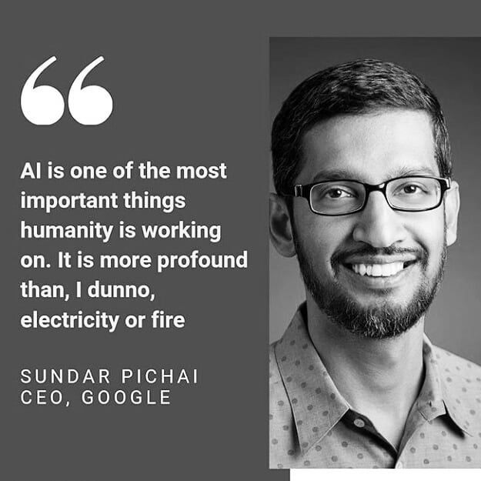

Slide 10
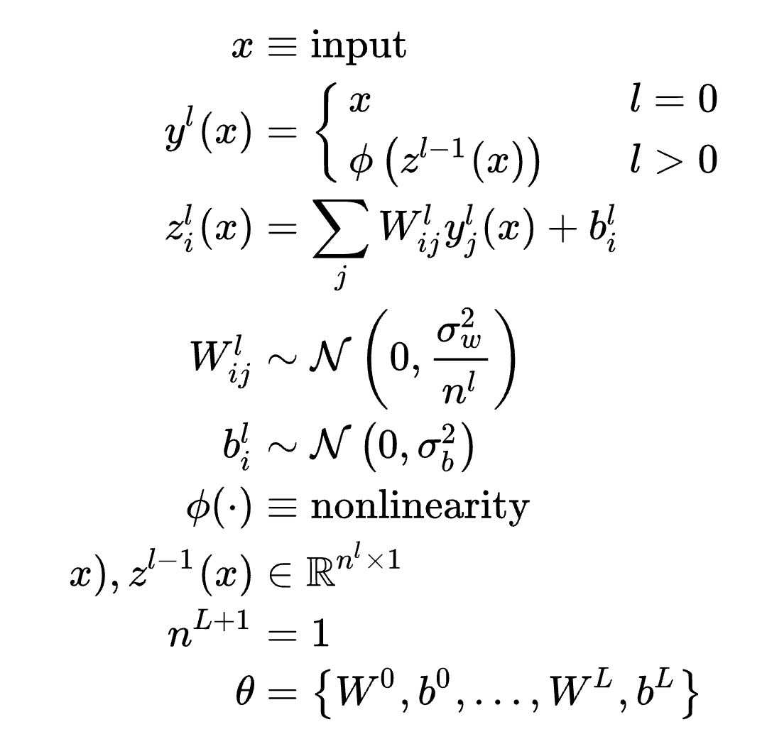
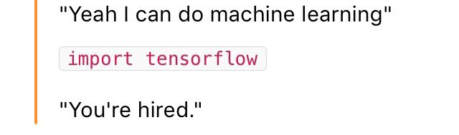
What does ML look like?
or

Slide 11
What does ML look like?
Data-Driven Algorithms
Accurate predictions
Powerful generalizations
Learning algorithms
Training data
output

Slide 12



Panda, cat, dog
Panda, dog, cat
*predicted labels*
Learning algorithms
Training data
output

Slide 13
Supervised Learning
Panda, cat, dog
Panda, dog, cat
*predicted labels*
Learning algorithms
Training data
output

Slide 14
Learning algorithms
Training data
output

Slide 15
*predicted clusters*
*predicted clusters*
Learning algorithms
Training data
output

Slide 16
Unsupervised Learning
*predicted clusters*
*predicted clusters*
Learning algorithms
Training data
output

Slide 17
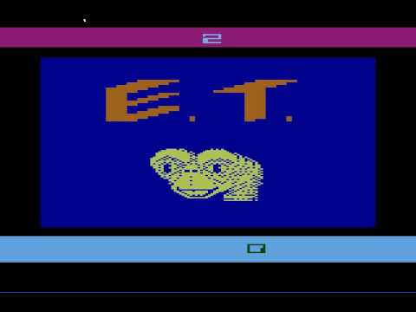
reward(+/-)
Learning algorithms
Training data
Output = action

Slide 18
Reinforcement Learning
reward(+/-)
Learning algorithms
Training data
Output = action

Slide 19
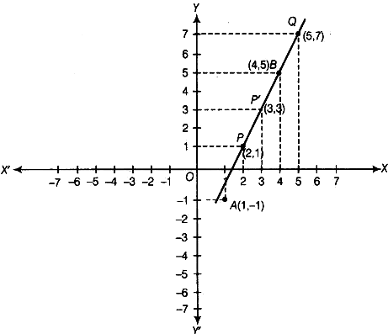

Slide 20
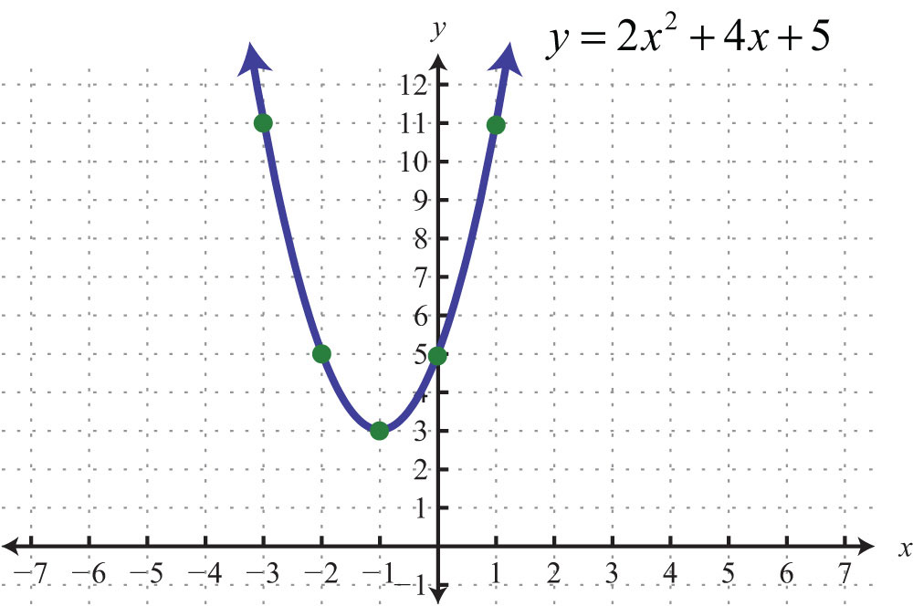

Slide 21
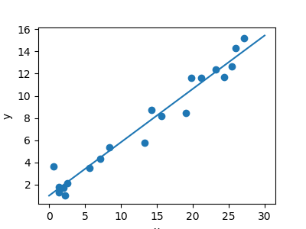
“Approximately” lie on a line.
Approximately?
Concept of “best fit”. For eg given:

Slide 22
“Approximately” lie on a line.
Approximately?
Concept of “best fit”. For eg given:

Slide 23

“Approximately” lie on a line.
Approximately?
Concept of “best fit”. For eg given:
Minimize the “error”

Slide 24

“Approximately” lie on a line.
Approximately?
Concept of “best fit”. For eg given:

Slide 25



Slide 26
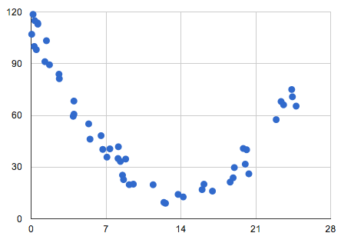

Slide 27
Entering into the world of “Deep” Learning
Sub-field of Machine Learning with the idea as:
“ Using brain simulations(not really), hope to:
– Make learning algorithms much better and easier to use.
– Make revolutionary advances in machine learning and AI.
I believe this is our best shot at progress towards real AI. “

Slide 28
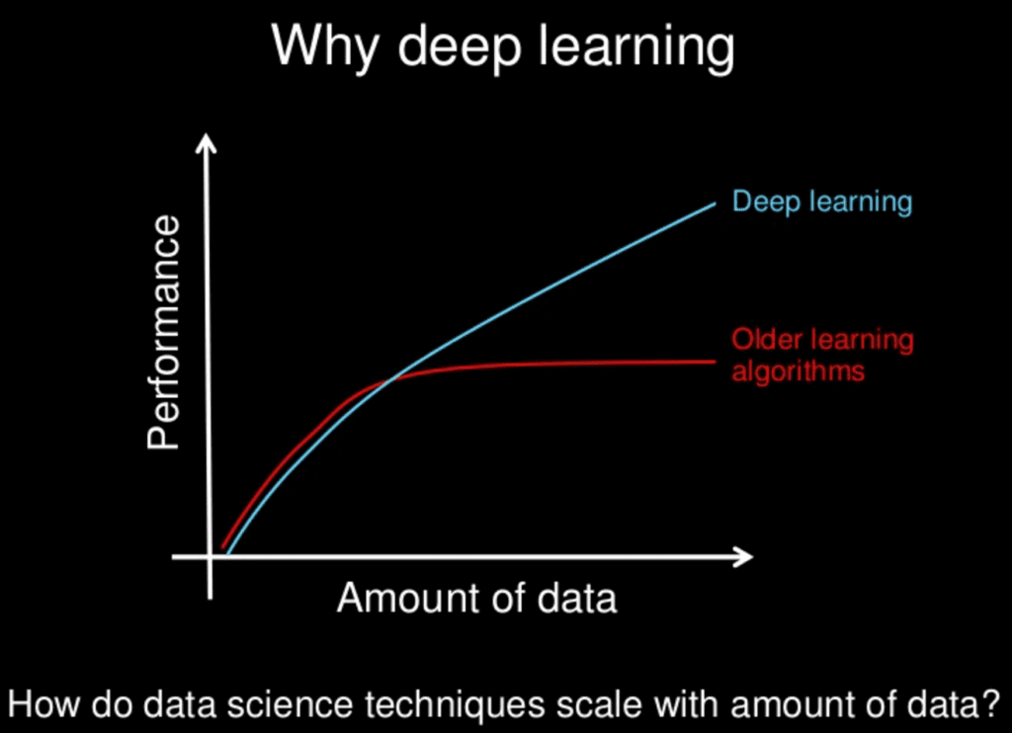
What’s ‘deep’ in it ??
The learning imitates the working of the human brain in processing data and creating patterns for use in decision making with the help of multi-layered neural networks
So ‘deep’ typically refers to the number of layers.
Notes:
For most flavors of the old generations of learning algorithms … performance will plateau. … deep learning … is the first class of algorithms … that is scalable. … performance just keeps getting better as you feed them more data.

Slide 29
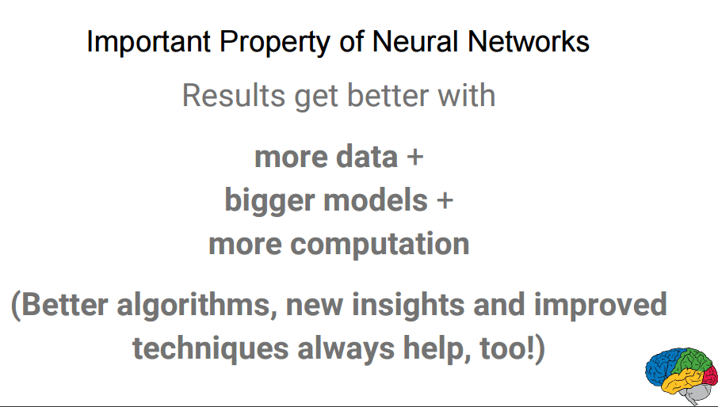
The Concept of Neural Networks
Neural net consists of thousands or even millions of simple processing nodes that are densely interconnected. Most of today’s neural nets are organized into layers of nodes.
An individual node might be connected to several nodes in the layer beneath it, from which it receives data, and several nodes in the layer above it, to which it sends data.

Slide 30
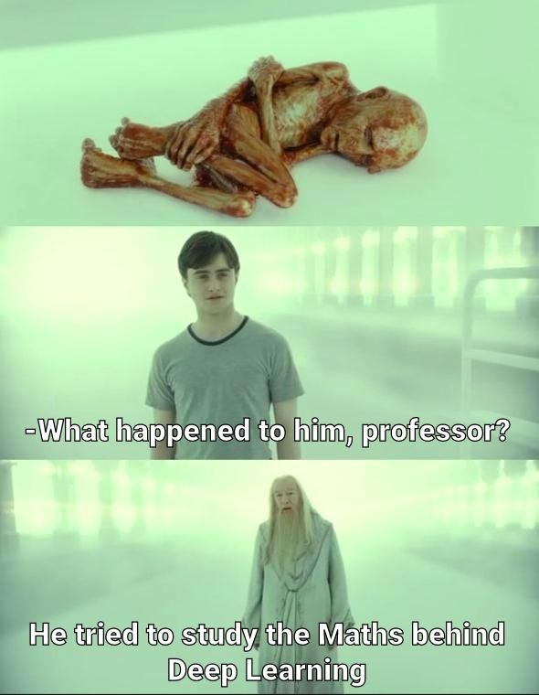
Belief->
But you don’t need to worry about, ‘coz NJACK is there for you `:)
Let’s begin !!!

Slide 31
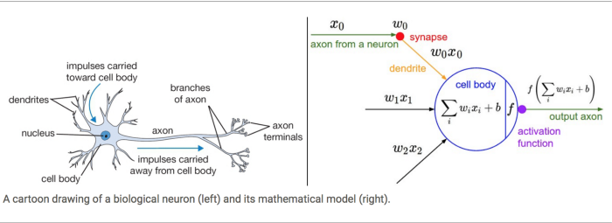
A single neuron
The basic unit of computation in a neural network is the neuron, often called as a node or unit. It receives input from some other nodes, or from an external source and computes an output. Each input has an associated weight (w), which is assigned on the basis of its relative importance to other inputs. The node applies a function f (defined below) to the weighted sum of its inputs.

Slide 32
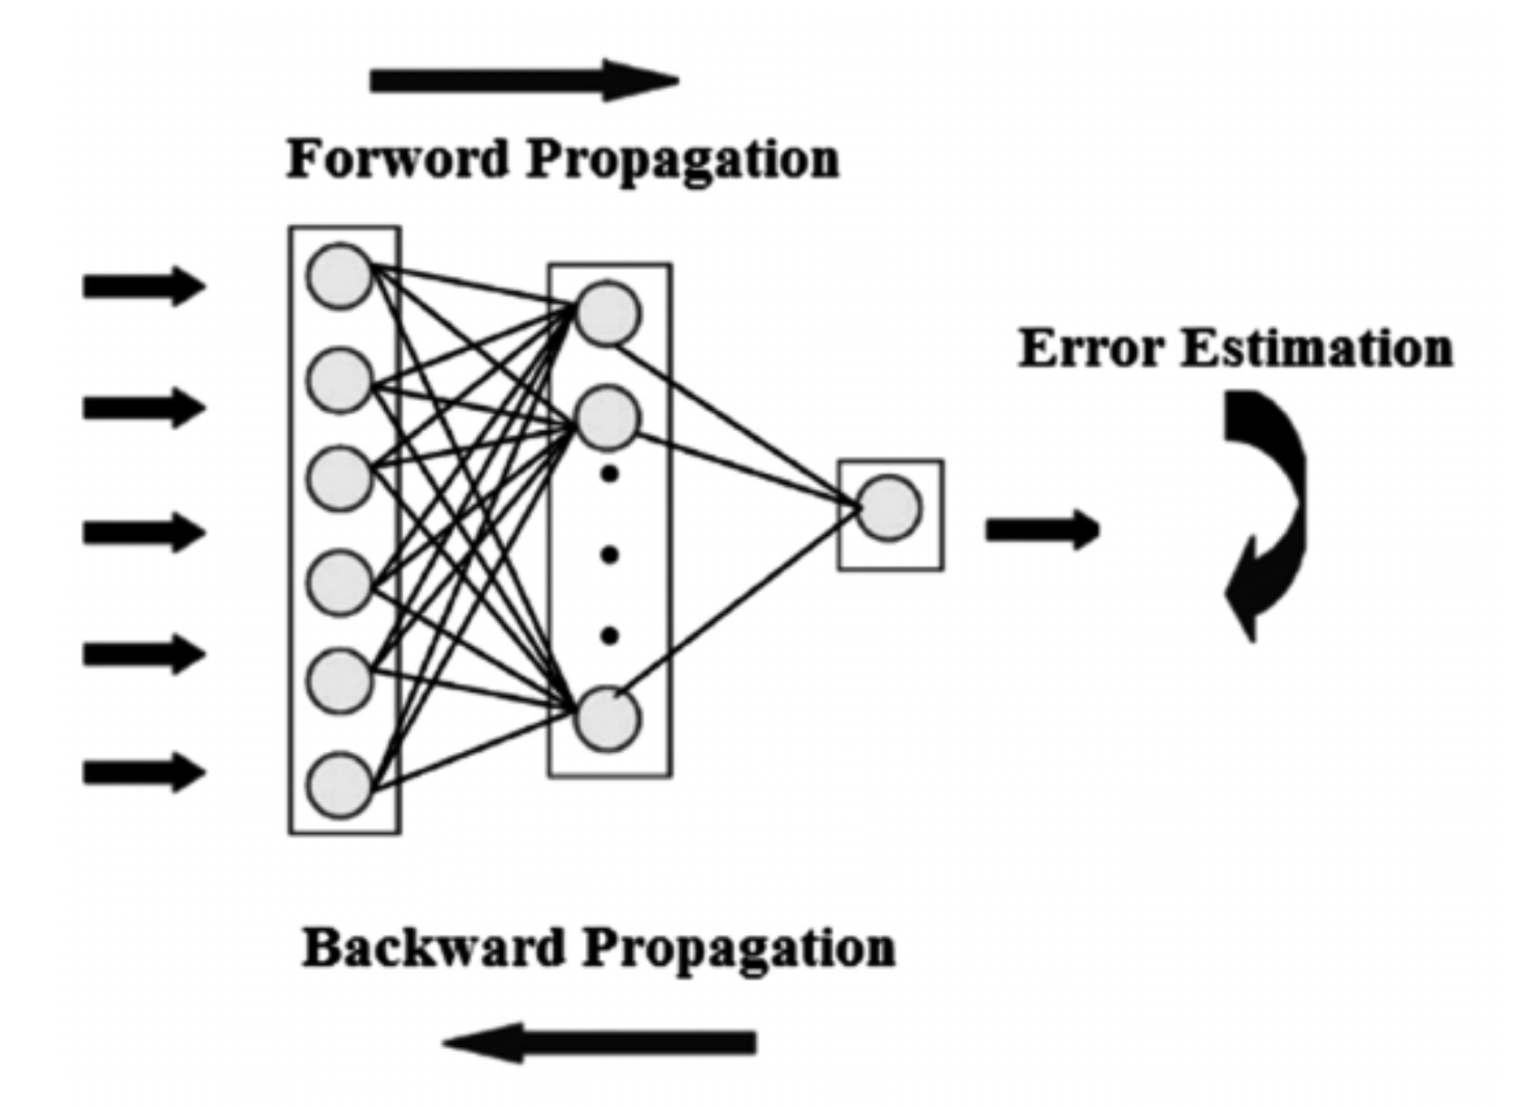
Train your own neural network!
Initialize your neural network
Forward Propagation: Pass in the input in you network
Collect the output generated
Find out how your model performed using a cost function
Back Propagation: Using the cost function, make changes to your network
Repeat above process until your network performs as desired!
A neural network learns from its mistakes!

Slide 33
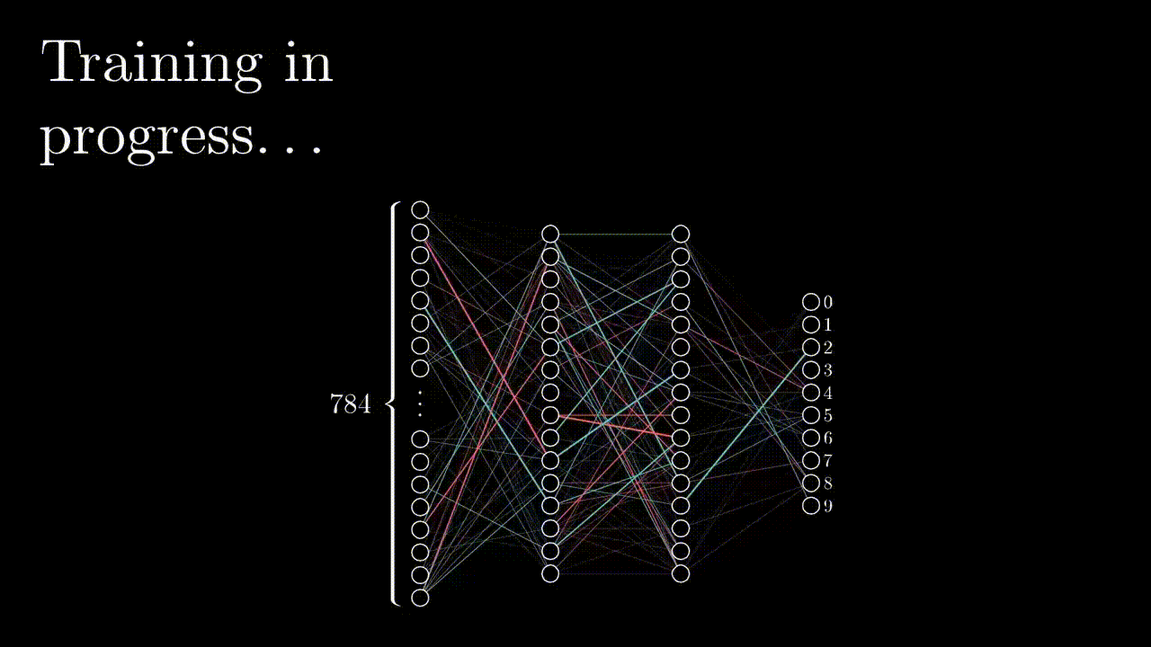
Train your own neural network!

Slide 34



Notations
Weight of connection between ‘i’th neuron of ‘L’th layer and ‘j’th neuron of ‘L-1’th Layer
Bias added in ‘j’th neuron of ‘L’th layer
Activation of ‘j’th neuron of ‘L’th layer

Slide 35
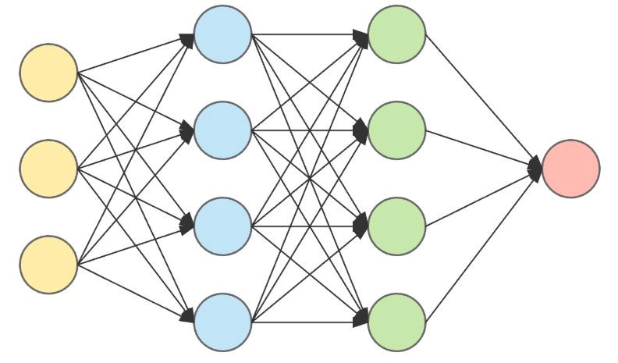
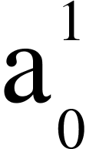
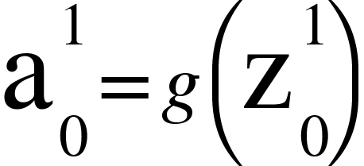
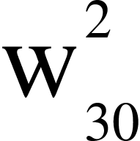
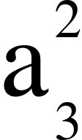
Notations

Slide 36

What are weights?
Gives us control over output given an input x
Controls how much the output is ‘sensitive’ to a given input
Helps to generate a prediction function

Slide 37

What are weights?
Gives us control over output given an input x
Controls how much the output is ‘sensitive’ to a given input
Helps to generate a prediction function

Slide 38
How do I deal with this !?

Slide 39
Need a constant term, Bias !
Gives us more control over the output given an input x
Allows the model to learn a constant term in the function
Helpful if one wants to ‘shift’ the output to a side

Slide 40
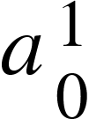
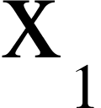
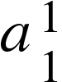
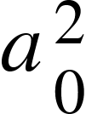
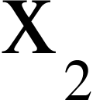
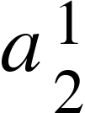
Forward Propagation
The act of moving through our neural network to generate predictions on the basis of a given input and weights and biases

Slide 41

Forward Propagation

Slide 42
But why this activation function?

Slide 43
But why this activation function?
Helps to create more complex models
Adds non-linearity to our model
Without activation functions, our neural network is just a linear regression model!
Without activation functions:

Slide 44
But why this activation function?
Helps to create more complex models
Adds non-linearity to our model
Without activation functions, our neural network is just a linear regression model!
With activation functions:

Slide 45
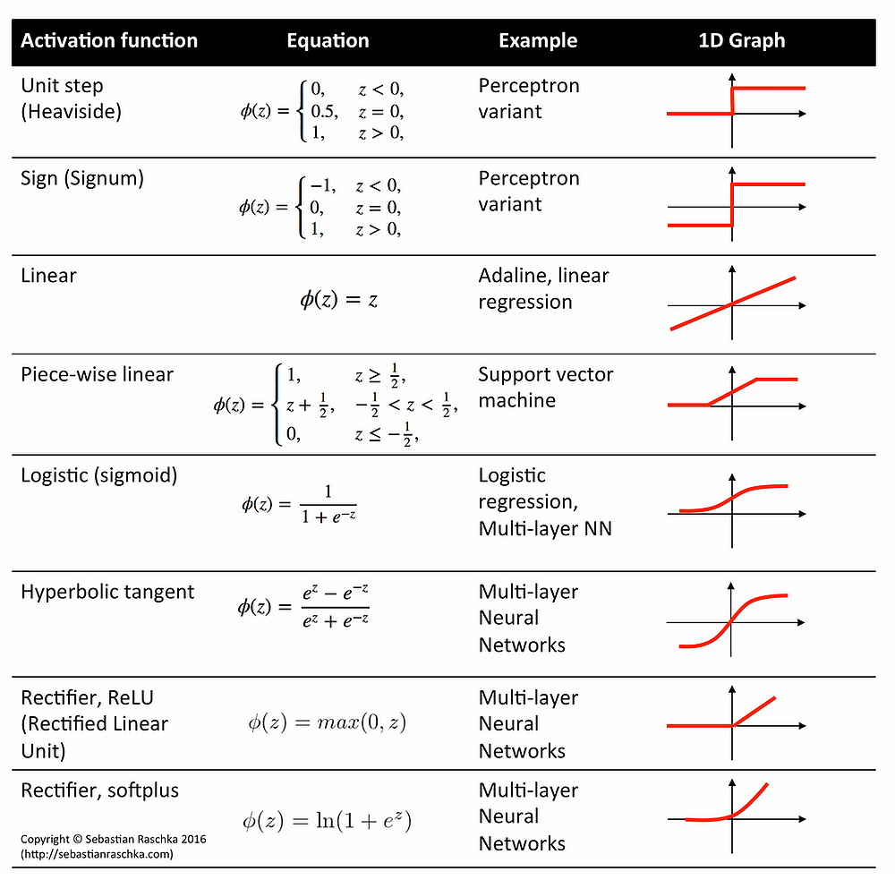
Some Examples
Of
Activation functions

Slide 46

Cost Function
A function which helps analyze how well the neural network has performed
High Cost denotes poor performance/bad output by the neural network
Low Cost denotes good performance/good output by the neural network

Slide 47

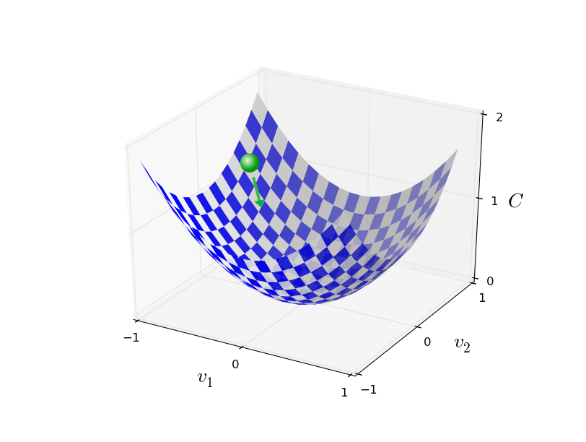
Finding such W and b is our only concern!!
And thus we have to “backpropagate” the model to find inputs such that it satisfies our need!!

Slide 48
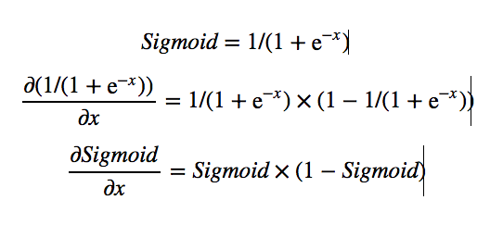
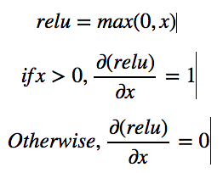
Gradient Descent
Important Derivatives:
Sigmoid: Relu:

Slide 49

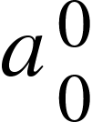
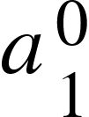
Backpropagation

Slide 50

Backpropagation

Slide 51

Gradient Descent
Updating the parameters ‘w’ and ‘b’ as per the gradient :
These updated parameters are again fed in the model for the forward propagation and again the model backpropagates to minimize the cost function and thus the cycle repeats….

Slide 52

Here we have used cost as a cross entropy function, we can change it to our needs as quadratic cost function,etc. but the most common is cross entropy.
Also changes can be brought in the choice of the activation function.Here we had used sigmoid in all the layers, you can choose Relu,tanh,leaky Relu in any of the layers.For binary classification, last layer should have sigmoid activation and in case of multivariable classification, last layer can have softmax activation.
We can also change learning rate,
as per our need.
All these falls under the section of hyperparameter tuning using which we can improve our model and increase its accuracy!!

Slide 53
Resources
A Neural Network Playground (tensorflow.org)
Njack-IITP/ML_Discussions: Resources for Competitive ML and Research ML discussions (github.com)
Machine Learning | Coursera
ML-AI-Meetups/Resources.md at master · dsciitpatna/ML-AI-Meetups (github.com)
Neural networks - 3Blue1Brown
An Introduction to Neural Networks from scratch - victorzhou.com
Home - colah's blog
A Visual and Interactive Guide to the Basics of Neural Networks – Jay Alammar

Slide 54
Presented by-
Parth Kanani
Aditya Samantaroy
Help with content- Sushant Sinha
Akshat Porwal
Thank You!!

